Slide 1
ABMS Integration
(American Board of Medical Specialties)

Slide 2
Introduction
ABMS is a non- profit organisation of approved medical boards i.e Member Boards which represents 24 broad areas of specialty medicine.
It is a certification organisation for physicians in US.
ABMS certify specialists in more than 150 medical specialties and sub-specialties.
ABMS-MOC(Maintenance of Certification) is a certification program for physicians which is certified by the ABMS

Slide 3
Things needed to Apply for Board Certification
Four years of premedical education in a college or university should be completed.
Having a medical degree (MD, DO or other credential approved by an ABMS Member Board) from a qualified medical school.
Complete three to five years of full-time experience in a residency training program accredited by the Accreditation Council for Graduate Medical Education (ACGME).
Provide letters of attestation from their program director and/or faculty.
Obtain an unrestricted medical license to practice medicine in the United States or Canada.
Pass a written and an oral examination created and administered by an ABMS Member Board.

Slide 4
List of ABMS Board
American Board of Dermatology
American Board of Obstetrics and Gynaecology
American Board of Ophthalmology
American Board of Otolaryngology
American Board of Orthopaedic Surgery
American Board of Paediatrics
American Board of Psychiatry and Neurology
American Board of Radiology
American Board of Urology

Slide 5
List of ABMS Board
American Board of Internal Medicine
American Board of Pathology
American Board of Surgery
American Board of Neurological Surgery
American Board of Anaesthesiology
American Board of Plastic Surgery
American Board of Physical Medicine and Rehabilitation
American Board of Oral and Maxillofacial Surgery

Slide 6
List of ABMS Board
American Board of Colon and Rectal Surgery
American Board of Preventive Medicine
American Board of Family Medicine
American Board of Allergy and Immunology
American Board of Nuclear Medicine
American Board of Thoracic Surgery
American Board of Emergency Medicine
American Board of Medical Genetics and Genomics

Slide 7
Maintenance of Certification(MOC)
The ABMS Program for MOC involves ongoing measurement of six core competencies defined by ABMS and ACGME:
Practice-based Learning and Improvement.
Patient Care and Procedural Skills
Systems-based Practice
Medical Knowledge
Interpersonal and Communication Skills
Professionalism

Slide 8
Maintenance of Certification(MOC)
These competencies are measured in this Program for MOC within a four-part framework:
Part I: Professionalism and Professional Standing.
Part II: Lifelong Learning and Self-Assessment.
Part III: Assessment of Knowledge, Judgment, and Skills.
Part IV: Improvement in Medical Practice.

Slide 9
Display of ABMS MOC
ABMS displays MOC status in its physician profiles to provide the public, the credentialing community and other professional organizations information that reflects the continuous nature of the certification process.
A physician’s certifying board determines whether or not he or she is meeting its MOC requirements.
This information is recognized as an important indicator of a physician’s engagement with the standards of their specialty to provide safe, quality medical care.
Notes:
Patients expect that their physician’s certification reflects ongoing education and practice improvement. They place faith in our certifications and check their physician’s certification at ABMS’ www.certificationmatters.org over a million times per year.

Slide 10
ABMS Solutions LLC.
ABMS Solutions LLC is the subsidiary of American Board of Medical Service(ABMS).
These resources allow hospitals and health systems as well as attorneys, insurance groups, and other professionals to check physicians records quickly, conveniently, and securely.

Slide 11
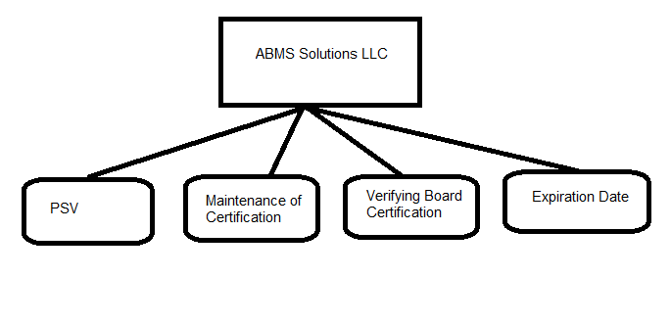
ABMS Solutions LLC.
Notes:
Works done by the ABMS llc

Slide 12
ABMS Solutions as a Product
Its includes annual subscription services, flexible search packages, and linkages direct to our electronic credentialing system.
Depending on the product chosen, data can include certification effective and expiration dates, historical information of Board Certifications, as well as participating in the ABMS Program for Maintenance of Certification.
Board Certification data offered by ABMS Solutions complies with all PSV requirements as set by the Joint Commission, the National Committee for Quality Assurance (NCQA), and URAC.
ABMS Solutions meets these rigorous requirements through the secure and timely reporting of credentialing information.

Slide 13
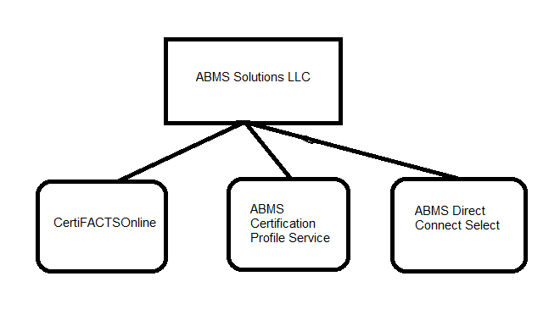
ABMS Solutions Products

Slide 14
CertiFACTS Online
The most widely accepted professional online resource for checking board certification information in the ABMS database.
CertiFACTS Online® is ABMS Solutions premier online resource to verify physician board certification.
The service of this resource is available for 1 year or 2 year annually which includes unlimited online verification.
This is helpful for medical staff/credentialers and hiring professionals, it is easy to verify and quickly find updated information for their needs.

Slide 15
CertiFACTS Online
Profiles from the service meet PSV requirements for The Joint Commission, NCQA, URAC and other accrediting agencies.
Its expanded search capabilities include physicians NPI number and Active State Licensure.
It provides unlimited access to information on more than 840,000 physicians.
It allows queries on 17 data fields.
FlexiSearch package plans of 10, 25, 50, or 100 queries available and have no expiration date.

Slide 16
ABMS Certification Profile Service
The ABMS Certification Profile Service’s FlexiSearch packages are ideal for organizations that require limited queries or perform lower volume board certification verifications per year.
This custom service provides as-needed access to the ABMS database.
Profiles from the service meet PSV requirements for The Joint Commission, NCQA, URAC and other accrediting agencies.
It gives access to the most current information with daily updates.
It shows the result of data with board certification effective and expiration dates, as well as complete physician certification history and Maintenance of Certification information.

Slide 17
Direct Connect Select
ABMS Direct Connect Select data service provides access to the ABMS database through select credentialing software systems.
With this single tool, users can query the database for multiple providers without interrupting other program activities.
Information accessed from this service meets PSV requirements for The Joint Commission, NCQA, URAC and other accrediting agencies.
It can be stored for current and future credentialing verification purposes.

Slide 18
Comparison of the three products
Features | CertiFACTS Online® | ABMS Certification Profile Service® | ABMS Direct Connect® Select
Meets Primary Source Verification (PSV) requirements for The Joint Commission | Yes | Yes | Yes
Meets Primary Source Verification (PSV) requirements for NCQA | Yes | Yes | Yes
Meets Primary Source Verification (PSV) requirements for URAC and other accrediting agencies | Yes | Yes | Yes
Daily data updates of the ABMS physician specialty certification data | Yes | Yes | Yes

Slide 19
Comparison of the three products
Features | CertiFACTS Online® | ABMS Certification Profile Service® | ABMS Direct Connect® Select
Approved business uses (Non-PSV required) | No | No | Yes
Credentialing software access based -currently accessible via: Cactus, CredentialSmart, Vistar and MDStaff | No | No | Yes
Daily data updates of the ABMS physician specialty certification data | Yes | Yes | Yes
Annual subscription (unlimited queries) | Yes | No | No

Slide 20
Comparison of the three products
Features | CertiFACTS Online® | ABMS Certification Profile Service® | ABMS Direct Connect® Select
Annual license agreement with custom query packages | No | No | Yes
Search packages (Plans of 10, 25, 50 or 100 query packages are available with no expiration date.) | No | Yes | No
Primary Source Verification (PSV) | Yes | Yes | Yes
Official ABMS Display Agent | Yes | Yes | Yes

Slide 21
Comparison of the three products
Features | CertiFACTS Online® | ABMS Certification Profile Service® | ABMS Direct Connect® Select
Search by NPI number and Active State Licensure | Yes | Yes | Yes
Daily data updates | Yes | Yes | Yes
Board Certification and Maintenance of Certification (MOC) Data available on the more than 840,000 physicians in the specialties and subspecialties of the 24 ABMS Member Boards | Yes | Yes | Yes
Build and save customized lists under "My Physicians" functionality | Yes | Yes | No

Slide 22
Comparison of the three products
Features | CertiFACTS Online® | ABMS Certification Profile Service® | ABMS Direct Connect® Select
Receive customize alerts based on "My Physicians" lists | Yes | Yes | No
Effective and expiration dates included in certification profiles | Yes | Yes | Yes
Complete certification history included in certification profiles | Yes | Yes | Yes
Search By Social Security Number | Yes | Yes | Yes

Slide 23
Comparison of the three products
Features | CertiFACTS Online® | ABMS Certification Profile Service® | ABMS Direct Connect® Select
Page through multiple certification profiles resulting from a search | Yes | Yes | NO
Date stamped results | Yes | Yes | Yes
Ability to upload data to your credentialing software | No | No | Yes

Slide 24
Thankyou

